Slide 1
GFRC FACADES
CREATING LANDMARKS WITH GRC
THE VILLA – STONE FINISH WITH GRC
PROJECT PROFILE

Slide 2
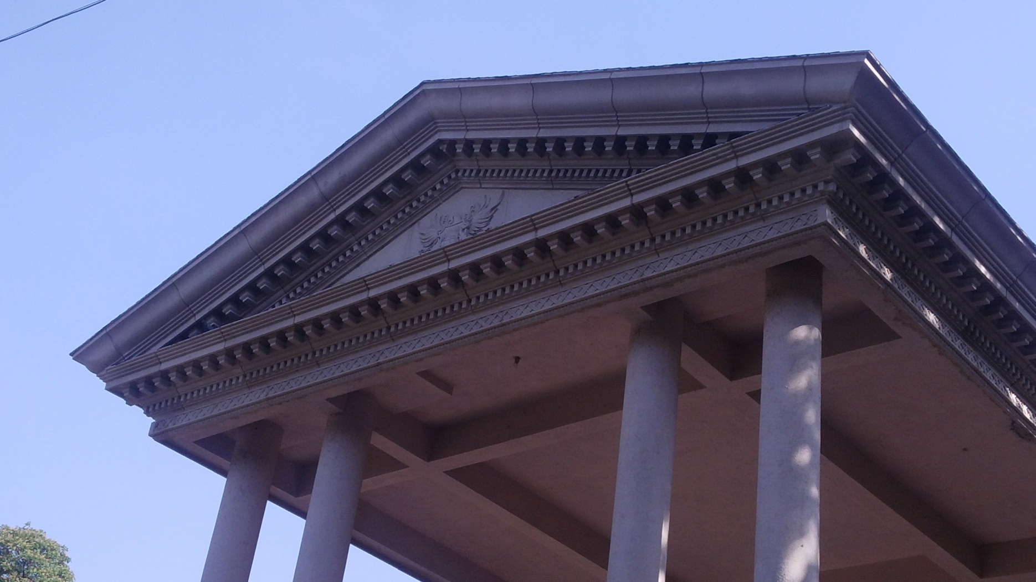
THE PEDIMENT

Slide 3
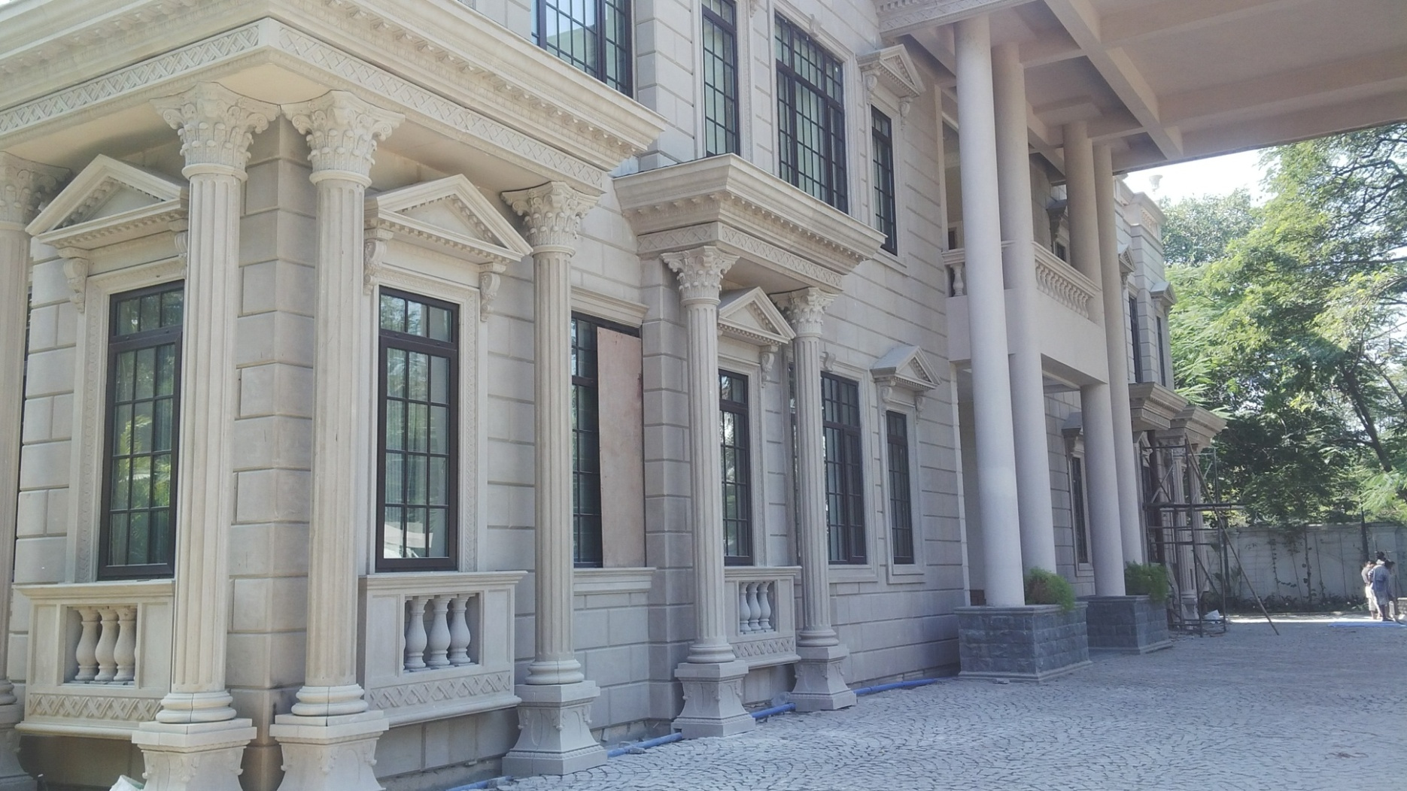
GRC AT ITS BEST
COLUMNS, CAPITAL, BASE, WINDOW SURROUND, CORNICES & PANELLING

Slide 4
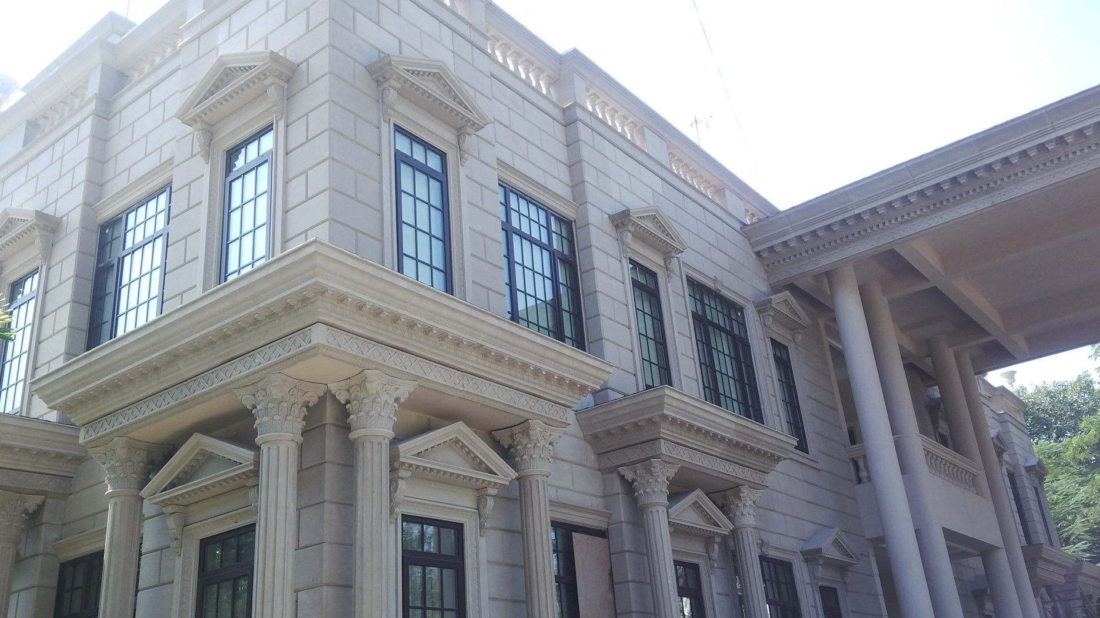
CORNICE
THE CORNICE ABOVE THE COLUMNS ARE IN ONE PIECE

Slide 5
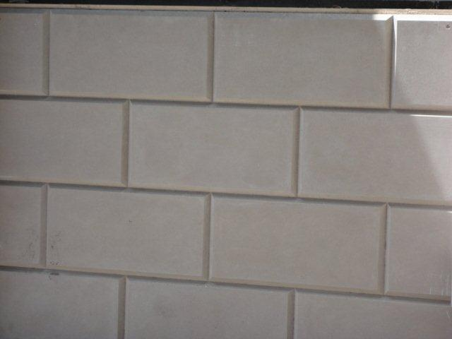
THE CLADDING PANEL IN GRC
WITH V GROOVE AS A FEATURE TO AVOID VISIBILITY OF JOINTS BETWEEN PANELS

Slide 6
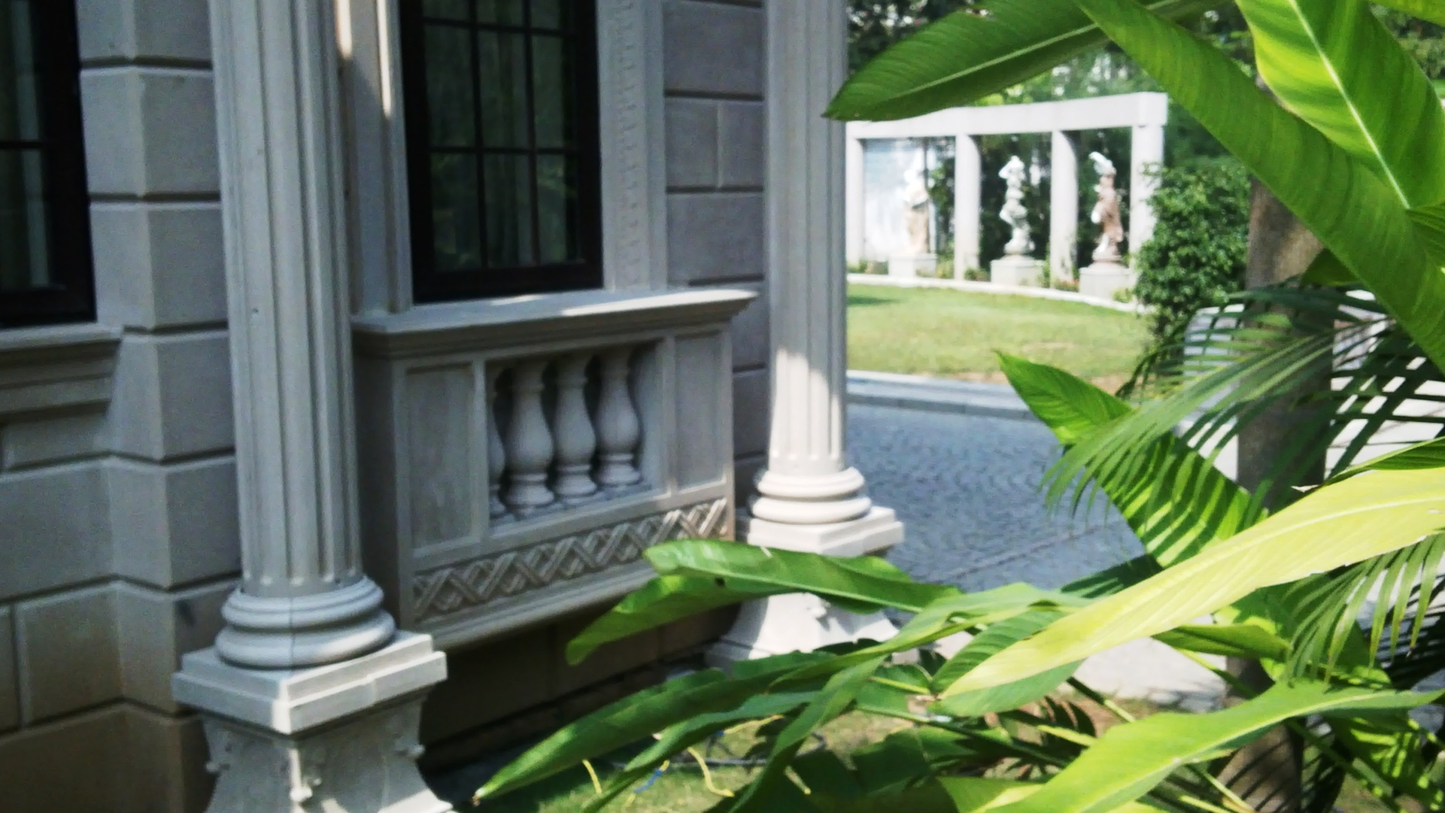
THE BALUSTERADE ENCASEMENT

Slide 7
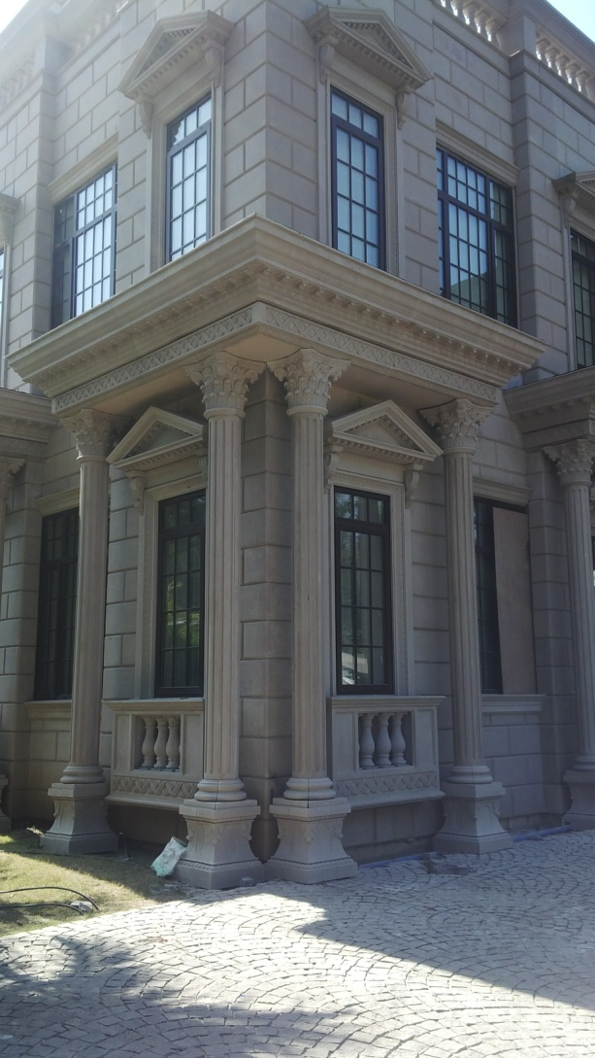
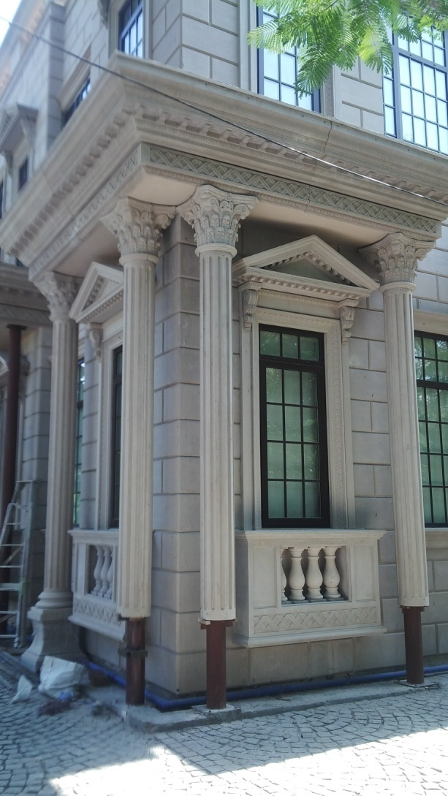
COLUMN PEDESTAL
BEFORE AND AFTER INSTALLATION

Slide 8
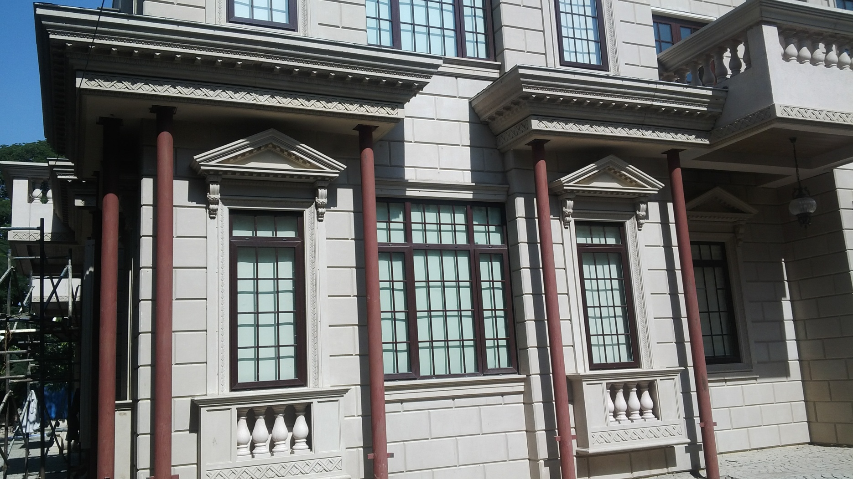
THE CLADDING PANEL
WITH STEEL FRAMES FOR GRC COLUMN TO BE ENCASED OVER

Slide 9
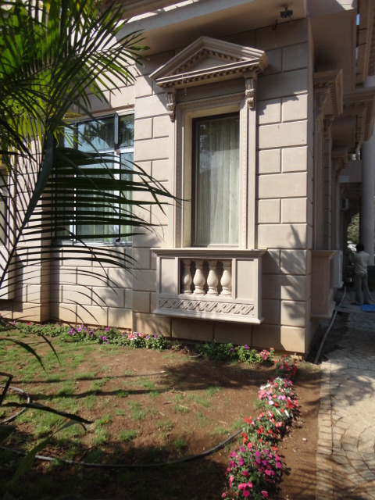
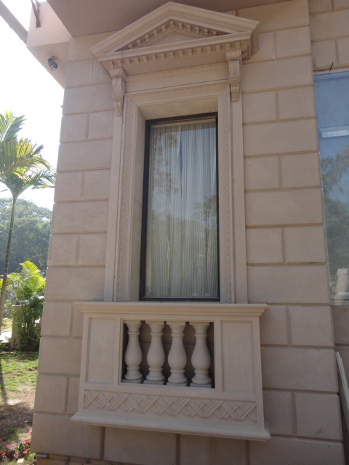
THE WINDOW SURROUND
PEDIMENT WITH WINDOW FRAME & BALUSTERADE SURROUND

Slide 10
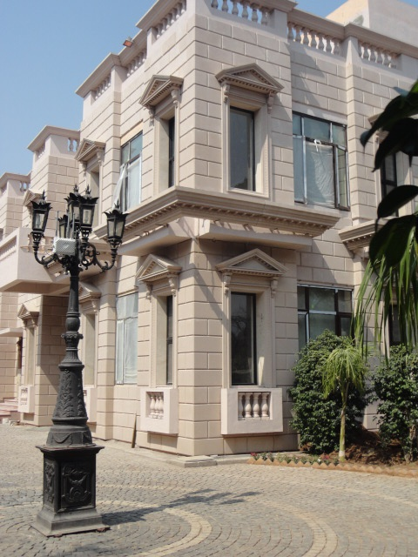
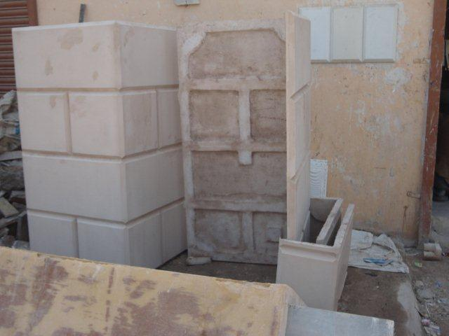
WE CREATE SEPARATE MOULDS FOR CORNER PANELS
THIS EXTRA LITTLE EFFORT HELPS IN A SHARP & NEAT FINISH

Slide 11
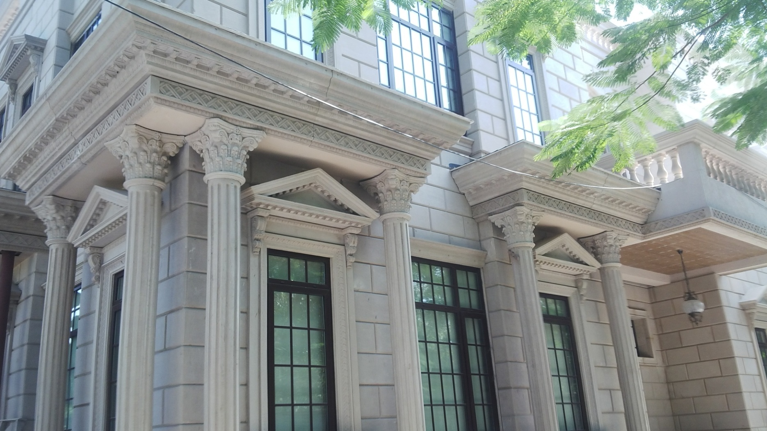
DECORATIVE ELEMENTS
CORNICES & BANDS OVER COLUMNS

Slide 12
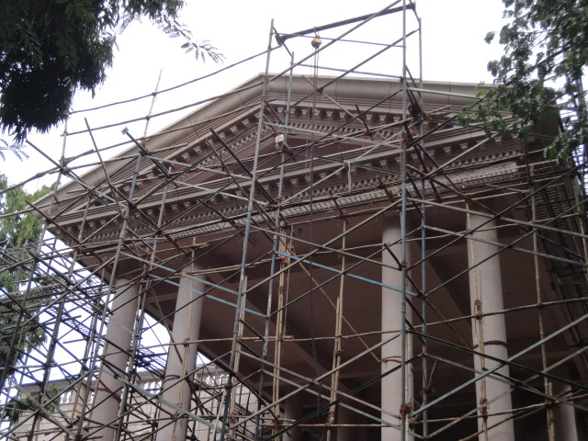
THE PEDIMENT
HAVING A DECORATIVE CORNICE AND THE EMBLAM WITHIN

Slide 13
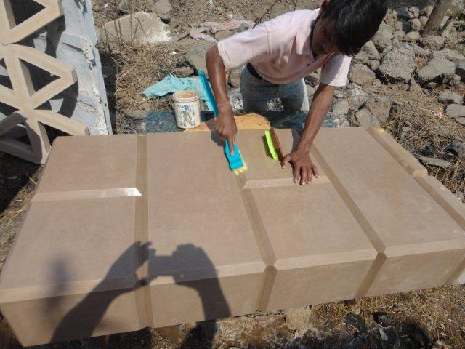
ACID WASH OF THE CORNER PANEL

Slide 14
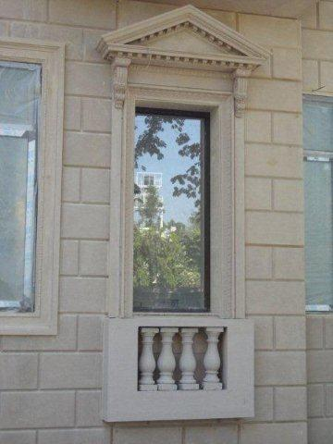
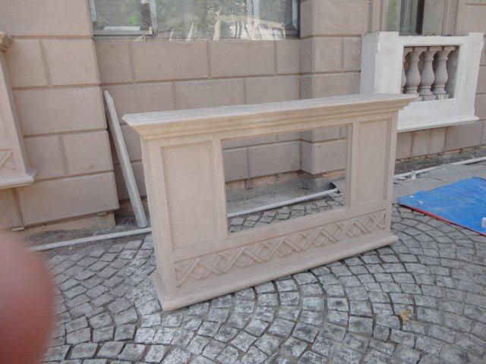
THE BALUSTERADE ENCASEMENT

Slide 15
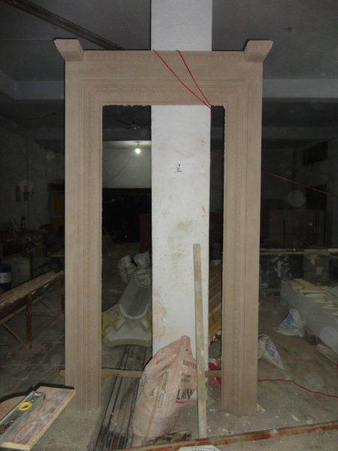
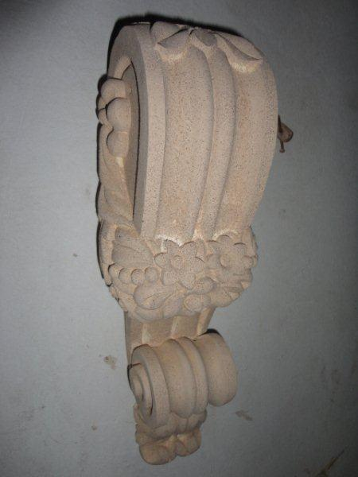
THE DECORATIVE WINDOW SURROUND
THE FRAME & BRACKET

Slide 16
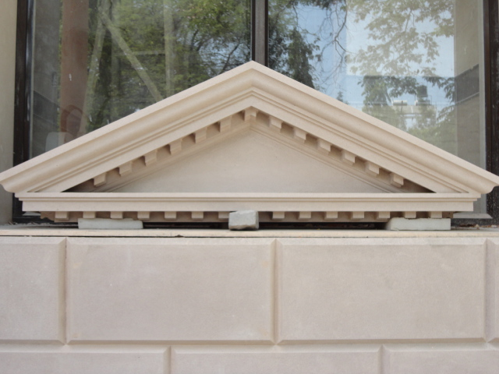
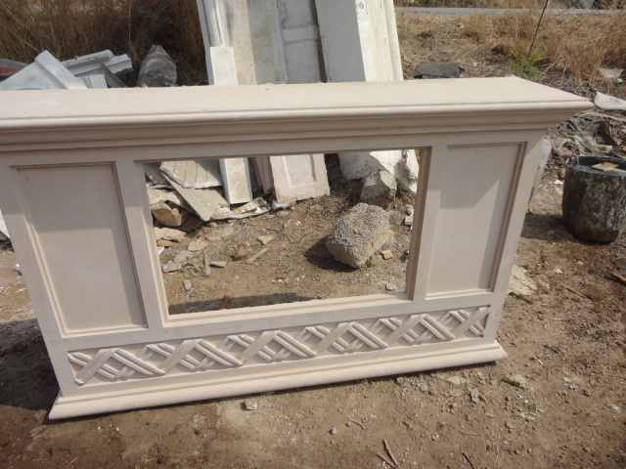
THE DECORATIVE WINDOW SURROUND
THE PEDIMENT & BALUSTERADE ENCASEMENT

Slide 17
THE COMPLETE WINDOW SURROUND

Slide 18
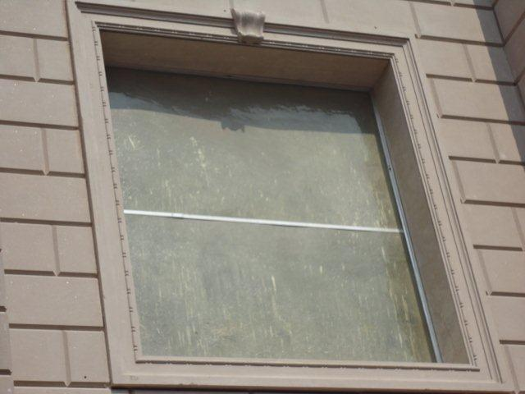
THE WINDOW FRAME

Slide 19
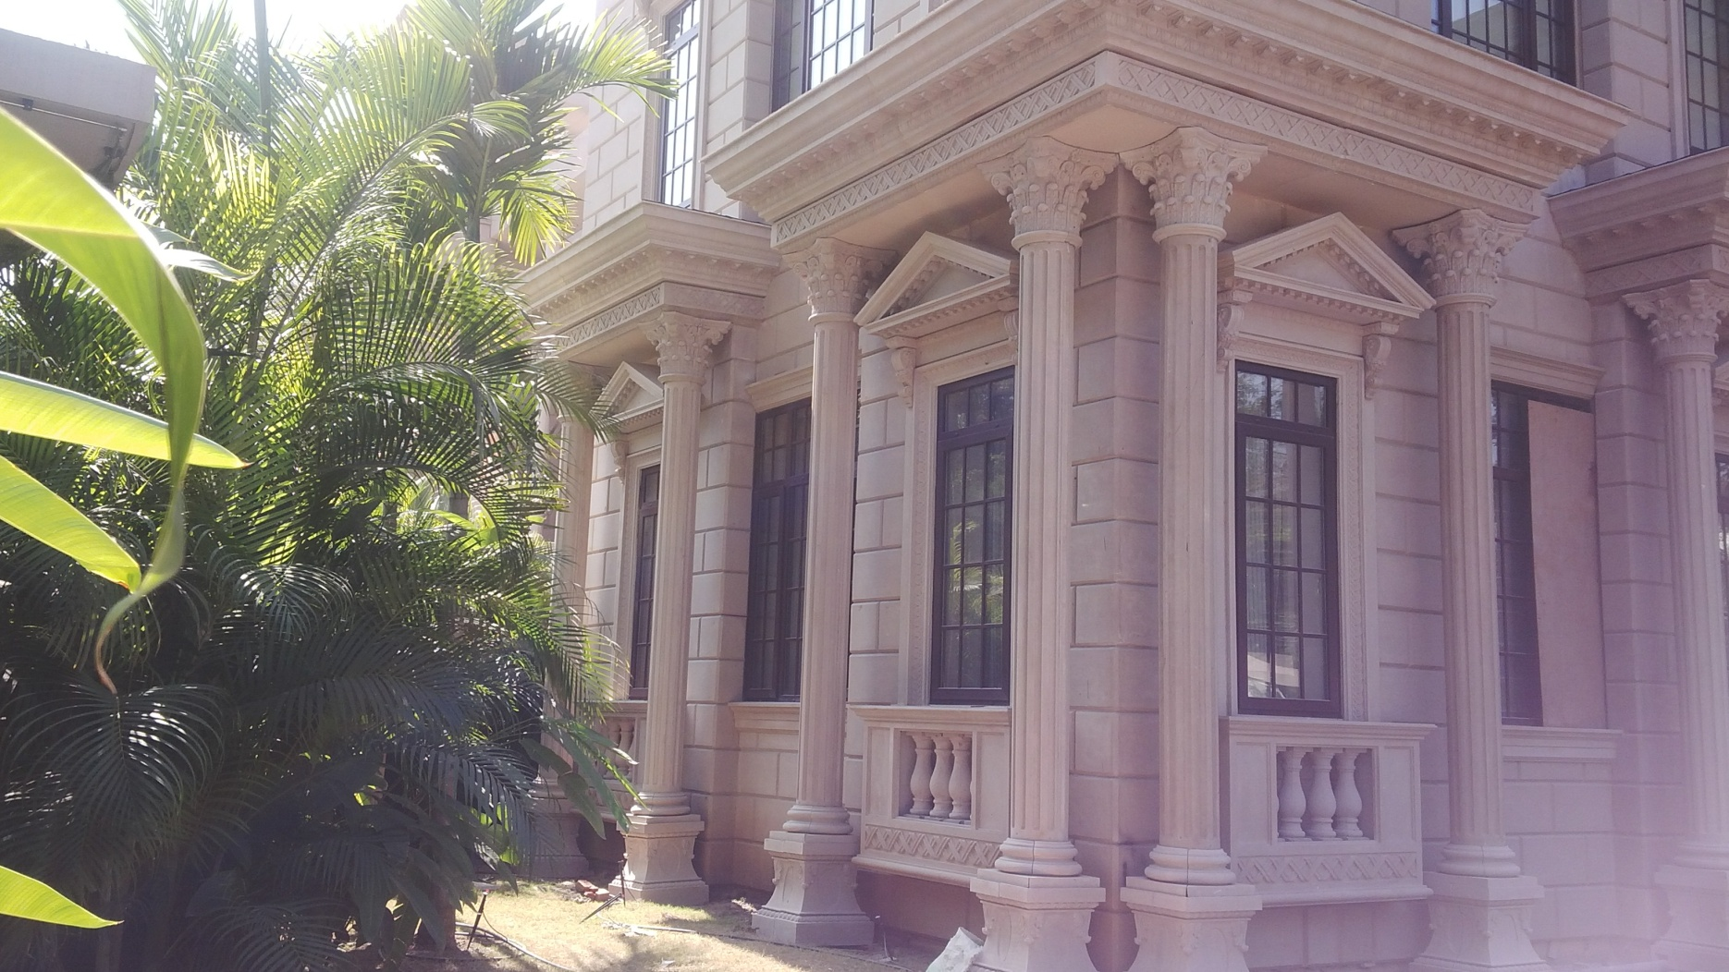
STONE FINISHED ELEMENTS

Slide 20
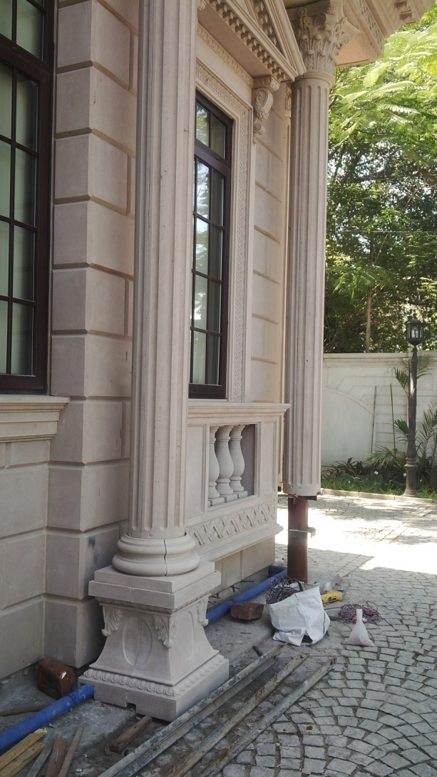
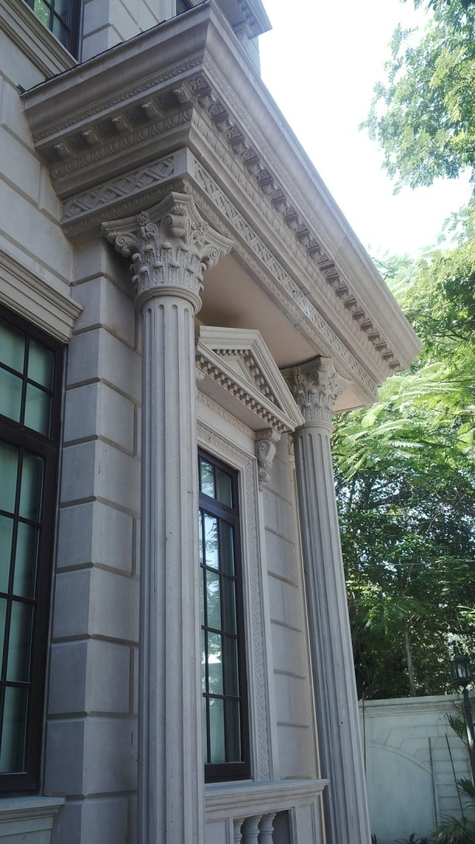
GRC COLUMN
FIXING OVER STEEL FRAMEWORK

Slide 21
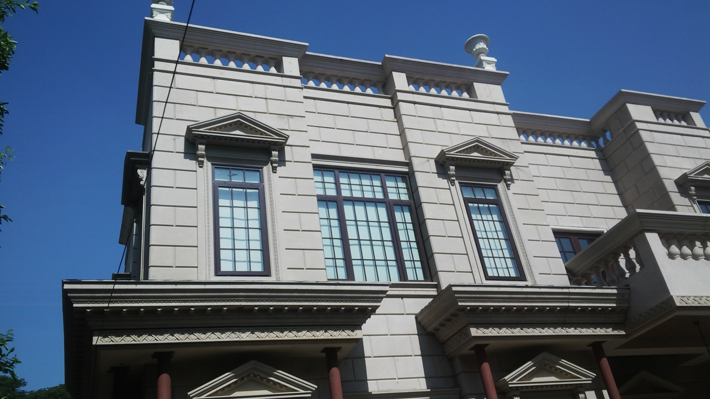
GRC PLANTERS
OVER THE ROOF TOP

Slide 22
CONTACT DETAILS
GFRC FACADES.
GFRC / GRC, GRG CEILINGS & PANELS, FRP WORKS, HIGH END DECORATIVE & ARCHITECTURAL WORKS & ACOUSTIC SOLUTIONS WITH EXPERTISE IN HOME THEATRES
SRIHARI NILKAR
MUMBAI
Mobile: 09867569395
nilkarsrihari@gmail.com

